Slide 1

BHARAT SANCHAR NIGAM LIMITED (BSNL) INTERNSHIP
PRESENTED BY:-
VENIGALLA SAI TEJA
RA1611004010270

Slide 2
HISTORY:
After providing it for 160 years, BSNL discontinued its telegraph service on 15 July 2013. It began delivering telegrams to the public in February 1855; this service was upgraded to a web-based messaging system in 2010 and had been offered through 182 telegraph offices across India.
It was incorporated on 15 September 2000 and assumed the business of providing telecom services and network management from the erstwhile Central Government Departments of Telecom Services (DTS) and Telecom Operations (DTO) as of 1 October 2000

Slide 3
INTRODUCTION:
Bharat Sanchar Nigam Limited (known as BSNL) is a public sector telecommunication company, headquartered in New Delhi , India.
In September 2018, The Department of Telecommunication approved BSNL's proposal to launch nation-wide 4G LTE services via the allocation of the 2100Mhz band.
BSNL is a major provider of GSM cellular mobile services under the brand name “CELLONE”.
BSNL provides a complete telecom services solution to enterprise customers including MPLS, P2P and Internet leased lines.

Slide 4
BROAD BAND SYSTEM AND SERVICES
Broadband indicates a means of connectivity at a high or ‘broad’ bandwidth, which is capable of delivering multiple services simultaneously.
There were no uniform standards for Broadband connectivity and various countries followed various standards. Recently ITU had stepped in and has defined Broadband.
According to International Telecommunication Union Broadband is defined as “Transmission capacity that is faster than primary rate ISDN, at 1.5 to 2 Mb/s” But in developing countries, as the average financial capability as well as usage, is low, broadband is redefined.

Slide 5
Features of Broadband
Fast connection to the Internet
Access to the services which would otherwise be impossible on a slower dial up connection. These include facilities such as downloading music or video footage, listening to your favourite radio station or downloading (or sending) large attached files with emails.
“Always-on” connection
Means that you are permanently connected to the internet;hence no need to dial up a connection every time you want to surf the web, send email, etc.
Flat-rate billing
If you choose an uncapped rate there will be no additional charges for the time you are online. You can use it as much or as little as you would like, for a fixed fee. Some connections are available at a lower cost, but limit you to the amount of data being downloaded (known as 'capped rate').
Dedicated connection
Simultaneous use of both telephone & data line.

Slide 6
BROADBAND SERVICES
High speed Internet
Means that you are permanently connected to the internet, and don't need to dial up a connection every time you want to surf the web, send email, etc.
Broadcast (BTV) & Time-shifted TV (TVOD)
Besides regular BTV services, Time shifted TV provides subscribers with virtual DVD controls to pause, start, stop, rewind and fast forward live TV programs. Users also have the flexibility to watch any previous broadcasted programs without pre-recording.
Video on Demand
Enables the user to select from an online library of content and select any of the available choices for viewing at a convenient time with full DVD like controls. This is similar to borrowing a Video for viewing.
Video Multicasting
Similar to cable or terrestrial broadcast – the user can join at any time but the stream begins and ends at the pre appointed times.

Slide 7
BROADBAND SERVICES
Interactive Gaming
Enables multiple players to play online games pitted against each other or against computers, through gaming servers employed by gaming content providers.
Audio and Video Conferencing
Share ideas, information, and applications using video or audio.
Dial VPN Service:
This service allows remote users to access their private network securely over the service provider’s core network.
Distant Learning
Consists of electronic classrooms with two-way and multi-way communication among teachers and students

Slide 8
IP ADDRESSING
In decimal the address range is 0.0.0.0 to 255.255.255.255
The IP address is of the form <networkID,hostID>
There are five classes of addresses A, B, C, D & E.
A, B & C classes are used to represent host and network address.
Class D is a special type of address used for multicasting.
Class E is reserved for experimental use.

Slide 9
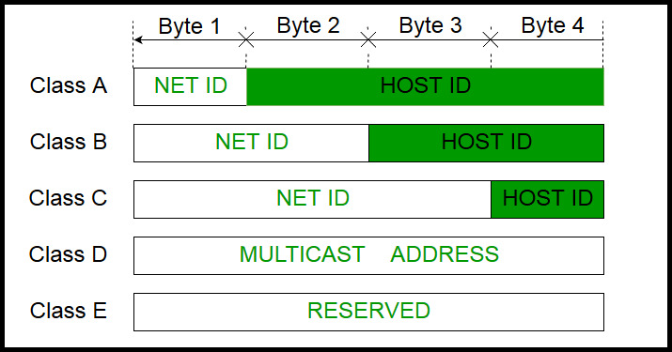
IP ADDRESSING

Slide 10
IP ADDRESSING
IPv4 address is divided into two parts:
Network ID
Host ID
Class A:
IP address belonging to class A are assigned to the networks that contain a large number of hosts.
The network ID is 8 bits long.
The host ID is 24 bits long.
2^7= 128 network ID
2^24 – 2 = 16,777,214 host ID
IP addresses belonging to class A ranges from 1.x.x.x – 126.x.x.x

Slide 11
IP ADDRESSING
Class B:
IP address belonging to class B are assigned to the networks that ranges from medium-sized to large-sized networks.
The network ID is 16 bits long.
The host ID is 16 bits long.
2^14 = 16384 network address
2^16 – 2 = 65534 host address
IP addresses belonging to class B ranges from 128.0.x.x – 191.255.x.x.
Class C:
IP address belonging to class C are assigned to small-sized networks.
The network ID is 24 bits long.
The host ID is 8 bits long.
2^21 = 2097152 network address
2^8 – 2 = 254 host address
IP addresses belonging to class C ranges from 192.0.0.x – 223.255.255.x.

Slide 12
IP ADDRESSING
Class D:
IP address belonging to class D are reserved for multi-casting.
Class D does not posses any sub-net mask. IP addresses belonging to class D ranges from 224.0.0.0 – 239.255.255.255.
Class E:
IP addresses belonging to class E are reserved for experimental and research purposes. IP addresses of class E ranges from 240.0.0.0 – 255.255.255.254. This class doesn’t have any sub-net mask.
Host ID’s are used to identify a host within a network.
Within any network, the host ID must be unique to that network.
Hosts that are located on the same physical network are identified by the network ID, as all host on the same physical network are assigned the same network ID.

Slide 13
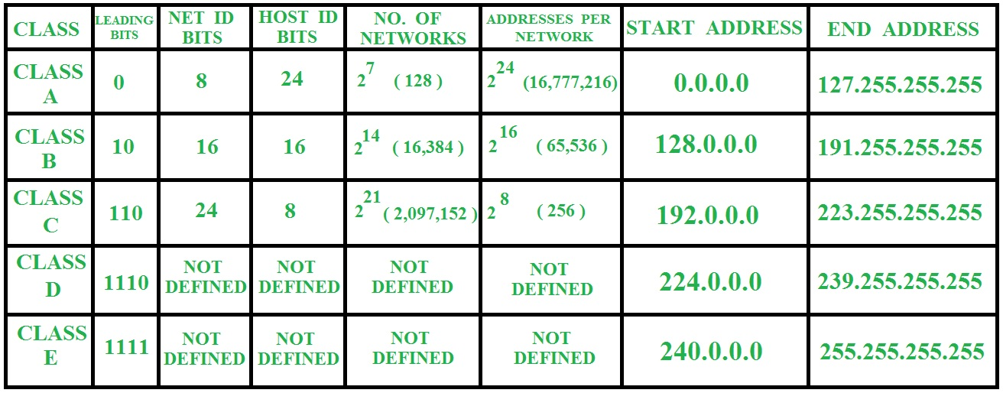
TABULAR OF IP ADDRESSING

Slide 14
TELEPHONE EXCHANGE SERVICES
Manual Exchange
In this generation, number dialing facility in not available at the customer end.
A transmitter, receiver and the ringer equipment is available at Customer premises.
Call connectivity will be arranged manually by an operator present in the exchange.
The operator feeds the ringing supply from the exchange to the calling customer for giving call alert.
After that the operator physically connects the calling and the called parties.
Automatic Exchanges
In this generation, complete automatic call connectivity was invented .
Electronic Exchange
With the invention of electronic exchanges the practical difficulties with the automatic exchanges were solved.
The customer was provided with lot of advanced features.

Slide 15
FIRST GENERATION(1G)
Generation #1 – Analog [routines for sending voice]
All systems are incompatible
No international roaming
Little capacity – cannot accommodate masses of subscribers
SECOND GENERATION(2G):
Generation #2 – digital [voice encoding]
Increased capacity
More security
Compatibility
Can use TDMA or CDMA for increasing capacity

Slide 16
SWITCHING
Switch is defined as Establishing a Temporary Connection From the calling subscriber to the called Subscriber.
Switch is a Device that makes the connection and breaks the connection.
Switch is a device that channels incoming data from any of multiple input ports to the specific output that will take the data towards its intended destination.
The process performed by a switch is called SWITCHING.
The interconnection of circuits in order to establish a temporary connection between two or more subscribers is also called as SWITCHING.
Switching types
Circuit switching
packet switching
Message switching

Slide 17
TYPES OF SWITCHING
Circuit Switching
Dedicated communication path established for the entire duration of the conversation
e.g. telephone network
Packet Switching
Data sent out in sequence
Small chunks (packets) of data at a time
Packets passed from node to node between source and destination
E.g. computer to computer communications
Message Switching
The switching network sets up a temporary connection between two or more exchange terminations and ensures transmission of signals (speech & data) between these terminations in digital form with reliable accuracy.

Slide 18
EXTERNAL CABLES
External Plant –Different stages
MDF(Main Distribution Frame)
Primary Cable
Pillar
Secondary cable
DP(Distribution Point)
Drop wire/Service wire
LJU(Line Jack Unit)/Rosette box
PBT(Push Button Telephone Instrument)

Slide 19
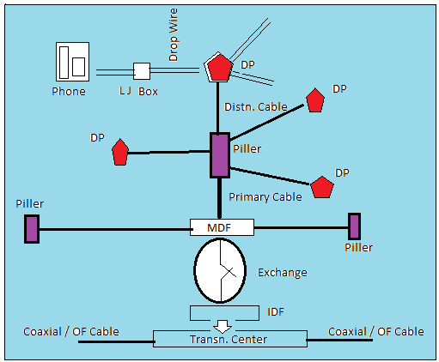
FUNCTIONING OF EXTERNAL CABLES

Slide 20
EXTERNAL CABLES
MDF is starting location from which the UG cable will be arranged to the customers.
MDF can separated as two parts.
LINE SIDE and EXCHANGE SIDE
PILLARs are the intermediate testing boxes where the primary and distribution cable terminates.
U/G cables that connect the MDF and pillars are called as Primary cables.
U/G cables that connect the pillar and the DPs (Distribution Point) in that pillar area are called as Distribution cables.
ternal DPs/wall mountingDPs: DPs erected with in Building or Appartments of multi-stored bldgs or grouped houses.
Capacities of DPs: having capacities of 5,10,20 pairs.

Slide 21
EXTERNAL CABLES
BASING ON construction
Armoured- protection layers of Aluminium ,Steel tapes and outer strong PVC sheath will be available to protect the cable.
Being used as U/G cable
Unarmoured – PVC outer jacket and steel tapes wijj not be available and are being used in available U/G PVC DUCT systems only(duct will protect the cable)
Manholes (RCC Chambers)will be constructed for every 200 mts to draw the cables through ducts.
Generally only Higher Capacities of cables that too in Highly busy & concentrated areas to avoid frequent digging of Roads

Slide 22
TYPES EXTERNAL CABLES
Type of Insulation
Paper Insulated coppercore – Paper insulation & lead sheath for protection .Now a days not at all being used – heavy expensive due to lead sheath
PIJF(Polythene Insulated Jelly filled Cable) – presently using in BSNL – polythene Insulated & PVC as sheath for protection.
less expensive – easy laying &maintenance – identification and counting also easily remember Whereas in paper the counting is somewhat difficult and colors on paper will become pale after some time and also due to water entry.
Local Cable- of gauge 4 lbs & 6 ½ lbs
Inner Zone- direct MDF-upto a radius of 500 mts – 100pr/200pr
Primary Cable – 400pr,600pr,800pr,1000pr,1200,1600,2000pr
Secondary Cables-20pr,50pr,100pr
Junction Cable-Between two local exchanges of same city/town
capacity-20pr/10lbs,40pr/10lbs,50/10lbs, of distance between5-10km
Trunk Cable – cable betaween two different cities/towns of 10-20km distances
Capacity/Gauge- 20pr/20lbs, 10pr/40lbs, 20pr/40lbs

Slide 23
ROUTERS
A router is a common type of gateway positioned where two or more networks meet, including at each point of presence on the internet. Hundreds of routers might forward a single packet as it moves from one network to the next on the way to its final destination.

Slide 24
Types of Telephone Calls
1.Local Call:
Within the same exchange.
2.Out Going Call:
From one exchange to another exchange.
3.In Coming Call:
Starts from One Exchange and terminates in the other exchange.
4.Transit or Junction Call:
It acts as a Junction or Link between two different exchanges.
in the other exchange.
4.Transit or Junction Call:
It acts as a Junction or Link between two different exchanges.

Slide 25
Landline Telephones VS Cell Phones
. Connectivity:
Landline telephones are connected through a wire network.
Cell phones do not use wire network for connectivity.
Transmission:
Landline phones transmit signals through fibers.
Cell phones transmit signals through radio waves.
Types:
Landline have corded and cordless types.
Cell phones are simple, android and window phones.
Mobility:
Landlines are fixed and cannot be carried beyond a specific distance.
Mobile phones can be carried anywhere easily.
Internet:
Landline cannot be connected to internet.
Smart phones can be connected to internet.
Games:
One cannot play games on landline telephones.
Games can be played on cell phones.

Slide 26
THANK YOU

